Slide 1

Developing a Movie recommendation engine
with Spark

Slide 2
Agenda
At the end of the session, you will be able to know :
What is a recommendation engine
Major companies using recommendation engines
Approaches to recommendation engine
How to build a recommendation engine using Spark and MLib

Slide 3
Transition – Search to Recommendation
We are leaving the era of search and entering one of discovery. What’s the difference? Search is what you do when you are looking for something. Discovery is when something wonderful that you didn’t know existed, finds you
CNN Money
The race to create a smart Google

Slide 4
Why to recommend
Recommendations help user find information, products and services that user might not have thought of
In short Good recommendations makes life easier

Slide 5
Where recommendations can be used
There is no restriction on where recommendations can be used, its just limited by your own imagination
Recommendations can be used in a wide variety of industries and applications. Some of them are listed below
Travel
Online Shopping
Entertainment
Financial Services
Retail
Healthcare
.... and many others

Slide 6

What is a Recommendation Engine
A recommendation engine is a feature that filters items by predicting how a user might rate them.
It solves the problem of connecting your existing users with the right items in your massive inventory of products or content

Slide 7






Who uses Recommendation Engines
Some of the companies that have build their own recommendation engines

Slide 8
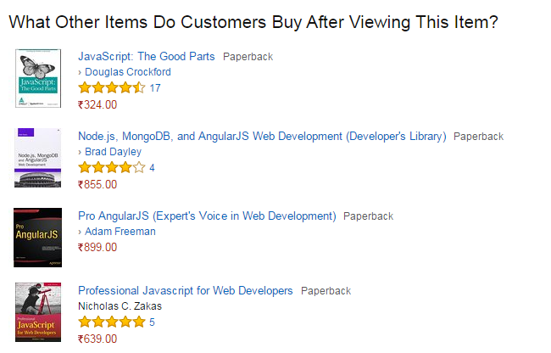
Recommendation Engine at Amazon
Recommended books by Amazon

Slide 9
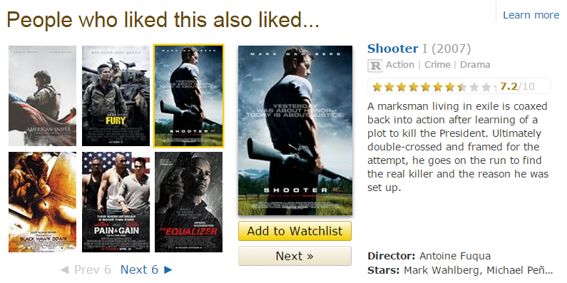
Recommendation Engine at IMDB
Movie recommendations by IMDB

Slide 10
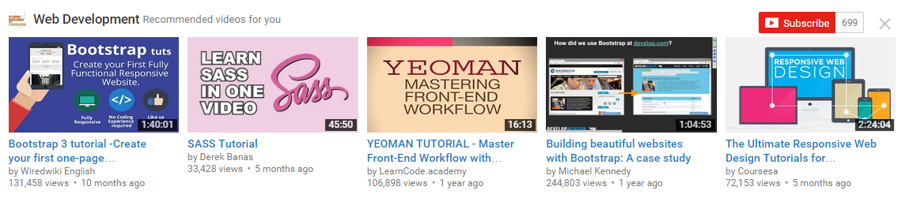
Recommendation Engine at Youtube
Recommended Videos by Youtube

Slide 11
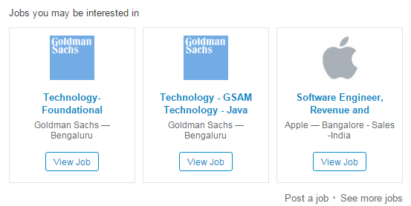
Recommendation Engine at LinkedIn
Job recommendations by LinkedIn

Slide 12
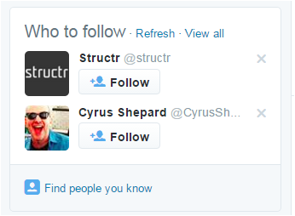
Recommendation Engine at Twitter
Recommended users by Twitter

Slide 13
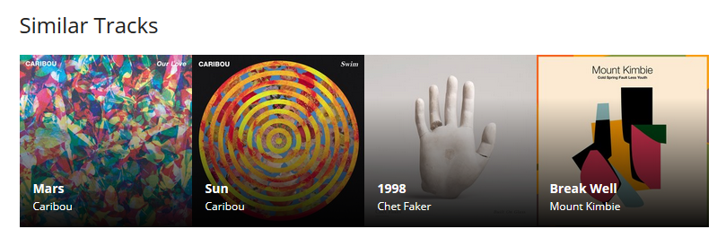
Recommendation Engine at LastFm
Recommended tracks by last.fm

Slide 14
Recommendation Approaches
Collaborative filter
The user will be recommended items that people with similar tastes and preferences liked in the past
Content based
The user will be recommended items similar to the ones that user preferred in that past
Hybrid methods
Combine approaches

Slide 15
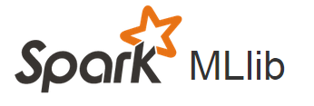

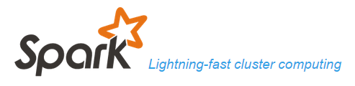
Implementing Recommendation Engine
To implement a recommendation engine we will require following :
Data source – to store historical data e.g. MySQL, MongoDB, HBase etc.
Spark - low latency computing
MLib – library of machine learning algorithms

Slide 16
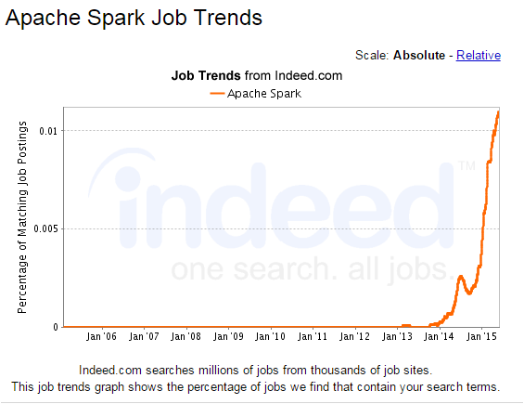
Spark Job Trends

Slide 17

Implementing Recommendation Engine
MLib
Data Source
Hadoop
Spark
Application
Recommendation Engine Architecture

Slide 18


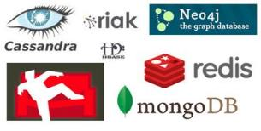



Data Source

Slide 19
Hadoop : The Ultimate Data Warehouse
Reliable
Flexible
Hadoop
Economical
Scalable

Slide 20

Spark
Apache Spark is a general-purpose in-memory cluster computing system
It is used for fast data analytics
Provides various high level tools like Spark SQL for structured data processing, MLib for Machine Learning and more
High Level APIs
High Level Tools
More…

Slide 21
MLib
MLib is Spark’s machine learning library
Provides simple & fast development environment for Spark
SparkSQL
MLib
Spark Streaming
Spark

Slide 23
References
http://recommender-systems.org/content-based-filtering/
http://archive.fortune.com/magazines/fortune/fortune_archive/2006/11/27/8394347/index.htm
http://ampcamp.berkeley.edu/big-data-mini-course/movie-recommendation-with-mllib.html
https://databricks-training.s3.amazonaws.com/movie-recommendation-with-mllib.html

